Slide 1
BirdBrain V. 0.1.1
April 12, 2022

Slide 2
BirdBrain - The Problem
A single Bird Photobooth 2.0, a motion activated camera, producing 9000 4k images per month.
4 RaspberryPI Zero W’s with 8 Megapixel cameras that we will be adding to the camera network.
A kickstarter camera that is a year behind delivery schedule, will eventually be added..
The pictures are used by a local bird food company and it would be easy if they knew which birds where in which photos without having to open each file.

Slide 3
Data
Kaggle Dataset
Processing
There is a kaggle data set that at the time of download had 325 bird species photo sets.
Images were split into train, validation and test sets.
Images: 224x224 pixels
Images were tested for being the correct size and uncorrupted.
Images were checked to ensure they were all unique.
Images resized to 480x480 pixels

Slide 4
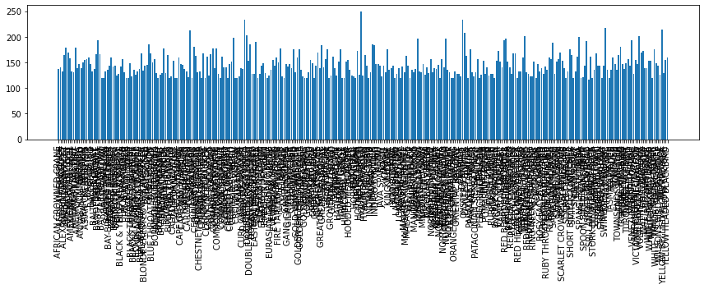
Distribution of Data by Species

Slide 5
Modelling
EffcientNet V2
EffcientNetV2L
EffcientNetV2 was the 2019 winner of ICML showing high accuracy with smaller models and faster training.
EffcientNetV2B0 - tested EffcientNetV2S - tested EffcientNetV2L tested and selected.
Trained against the dataset and with the initial training had a 71% accuracy. Images resized to the 480x480 model architecture increasing accuracy to 81%. Retrained to 83% over all.

Slide 6
Metrics:
Overall Accuracy: 83%
1344/1625
AFRICAN CROWNED CRANE accuracy: 0/5 0%
AFRICAN FIREFINCH accuracy: 5/5 100%
ALBATROSS accuracy: 5/5 100%
ALEXANDRINE PARAKEET accuracy: 4/5 80%
AMERICAN AVOCET accuracy: 5/5 100%
AMERICAN BITTERN accuracy: 5/5 100%
AMERICAN COOT accuracy: 5/5 100%
AMERICAN GOLDFINCH accuracy: 5/5 100%
AMERICAN KESTREL accuracy: 4/5 80%
AMERICAN PIPIT accuracy: 5/5 100%
AMERICAN REDSTART accuracy: 3/5 60%
ANHINGA accuracy: 5/5 100%
ANNA’S HUMMINGBIRD accuracy: 0/5 0%
ANTBIRD accuracy: 2/5 40%
ARARIPE MANAKIN accuracy: 5/5 100%
ASIAN CRESTED IBIS accuracy: 3/5 60%
BALD EAGLE accuracy: 5/5 100%
BALD IBIS accuracy: 0/5 0%
BALI STARLING accuracy: 5/5 100%
BALTIMORE ORIOLE accuracy: 5/5 100%
BANANAQUIT accuracy: 5/5 100%
BANDED BROADBILL accuracy: 5/5 100%
BANDED PITA accuracy: 5/5 100%
BAR-TAILED GODWIT accuracy: 5/5 100%
BARN OWL accuracy: 5/5 100%
BARN SWALLOW accuracy: 5/5 100%
BARRED PUFFBIRD accuracy: 3/5 60%
BAY-BREASTED WARBLER accuracy: 4/5 80%
BEARDED BARBET accuracy: 4/5 80%
BEARDED BELLBIRD accuracy: 5/5 100%
BEARDED REEDLING accuracy: 5/5 100%
BELTED KINGFISHER accuracy: 2/5 40%
BIRD OF PARADISE accuracy: 5/5 100%
BLACK & YELLOW bROADBILL accuracy: 5/5 100%
BLACK BAZA accuracy: 4/5 80%
BLACK FRANCOLIN accuracy: 4/5 80%
BLACK SKIMMER accuracy: 5/5 100%
BLACK SWAN accuracy: 5/5 100%
BLACK TAIL CRAKE accuracy: 5/5 100%
BLACK THROATED BUSHTIT accuracy: 5/5 100%
BLACK THROATED WARBLER accuracy: 5/5 100%
BLACK VULTURE accuracy: 5/5 100%
BLACK-CAPPED CHICKADEE accuracy: 5/5 100%
BLACK-NECKED GREBE accuracy: 5/5 100%
BLACK-THROATED SPARROW accuracy: 5/5 100%
BLACKBURNIAM WARBLER accuracy: 0/5 0%
BLONDE CRESTED WOODPECKER accuracy: 5/5 100%
BLUE COAU accuracy: 5/5 100%
BLUE GROUSE accuracy: 5/5 100%
BLUE HERON accuracy: 5/5 100%
BLUE THROATED TOUCANET accuracy: 5/5 100%
BOBOLINK accuracy: 3/5 60%
BORNEAN BRISTLEHEAD accuracy: 5/5 100%
BORNEAN LEAFBIRD accuracy: 3/5 60%
BORNEAN PHEASANT accuracy: 4/5 80%
BRANDT CORMARANT accuracy: 5/5 100%
BROWN CREPPER accuracy: 5/5 100%
BROWN NOODY accuracy: 5/5 100%
BROWN THRASHER accuracy: 4/5 80%
BULWERS PHEASANT accuracy: 5/5 100%
CACTUS WREN accuracy: 5/5 100%
CALIFORNIA CONDOR accuracy: 4/5 80%
CALIFORNIA GULL accuracy: 4/5 80%
CALIFORNIA QUAIL accuracy: 3/5 60%
CANARY accuracy: 5/5 100%
CAPE GLOSSY STARLING accuracy: 5/5 100%
CAPE MAY WARBLER accuracy: 5/5 100%
CAPPED HERON accuracy: 5/5 100%
CAPUCHINBIRD accuracy: 4/5 80%
CARMINE BEE-EATER accuracy: 4/5 80%
CASPIAN TERN accuracy: 5/5 100%
CASSOWARY accuracy: 4/5 80%
CEDAR WAXWING accuracy: 5/5 100%
CERULEAN WARBLER accuracy: 3/5 60%
CHARA DE COLLAR accuracy: 5/5 100%
CHESTNET BELLIED EUPHONIA accuracy: 4/5 80%
CHIPPING SPARROW accuracy: 2/5 40%
CHUKAR PARTRIDGE accuracy: 5/5 100%
CINNAMON TEAL accuracy: 5/5 100%
CLARKS NUTCRACKER accuracy: 5/5 100%
COCK OF THE ROCK accuracy: 5/5 100%
COCKATOO accuracy: 3/5 60%
COLLARED ARACARI accuracy: 3/5 60%
COMMON FIRECREST accuracy: 5/5 100%
COMMON GRACKLE accuracy: 5/5 100%
COMMON HOUSE MARTIN accuracy: 5/5 100%
COMMON LOON accuracy: 1/5 20%
COMMON POORWILL accuracy: 3/5 60%
COMMON STARLING accuracy: 5/5 100%
COUCHS KINGBIRD accuracy: 5/5 100%
CRESTED AUKLET accuracy: 5/5 100%
CRESTED CARACARA accuracy: 5/5 100%
CRESTED NUTHATCH accuracy: 5/5 100%
CRIMSON SUNBIRD accuracy: 5/5 100%
CROW accuracy: 4/5 80%
CROWNED PIGEON accuracy: 3/5 60%
CUBAN TODY accuracy: 4/5 80%
CUBAN TROGON accuracy: 4/5 80%
CURL CRESTED ARACURI accuracy: 4/5 80%
D-ARNAUDS BARBET accuracy: 5/5 100%
DARK EYED JUNCO accuracy: 5/5 100%
DOUBLE BARRED FINCH accuracy: 5/5 100%
DOUBLE BRESTED CORMARANT accuracy: 5/5 100%
DOWNY WOODPECKER accuracy: 5/5 100%
EASTERN BLUEBIRD accuracy: 3/5 60%
EASTERN MEADOWLARK accuracy: 4/5 80%
EASTERN ROSELLA accuracy: 4/5 80%
EASTERN TOWEE accuracy: 4/5 80%
ELEGANT TROGON accuracy: 4/5 80%
ELLIOTS PHEASANT accuracy: 3/5 60%
EMPEROR PENGUIN accuracy: 5/5 100%
EMU accuracy: 2/5 40%
ENGGANO MYNA accuracy: 4/5 80%
EURASIAN GOLDEN ORIOLE accuracy: 3/5 60%
EURASIAN MAGPIE accuracy: 5/5 100%
EVENING GROSBEAK accuracy: 5/5 100%
FAIRY BLUEBIRD accuracy: 5/5 100%
FIRE TAILLED MYZORNIS accuracy: 5/5 100%
FLAME TANAGER accuracy: 4/5 80%
FLAMINGO accuracy: 5/5 100%
FRIGATE accuracy: 3/5 60%
GAMBELS QUAIL accuracy: 1/5 20%
GANG GANG COCKATOO accuracy: 5/5 100%
GILA WOODPECKER accuracy: 4/5 80%
GILDED FLICKER accuracy: 5/5 100%
GLOSSY IBIS accuracy: 4/5 80%
GO AWAY BIRD accuracy: 5/5 100%
GOLD WING WARBLER accuracy: 4/5 80%
GOLDEN CHEEKED WARBLER accuracy: 3/5 60%
GOLDEN CHLOROPHONIA accuracy: 4/5 80%
GOLDEN EAGLE accuracy: 2/5 40%
GOLDEN PHEASANT accuracy: 5/5 100%
GOLDEN PIPIT accuracy: 5/5 100%
GOULDIAN FINCH accuracy: 5/5 100%
GRAY CATBIRD accuracy: 4/5 80%
GRAY KINGBIRD accuracy: 5/5 100%
GRAY PARTRIDGE accuracy: 0/5 0%
GREAT GRAY OWL accuracy: 5/5 100%
GREAT KISKADEE accuracy: 4/5 80%
GREAT POTOO accuracy: 3/5 60%
GREATOR SAGE GROUSE accuracy: 4/5 80%
GREEN BROADBILL accuracy: 4/5 80%
GREEN JAY accuracy: 4/5 80%
GREEN MAGPIE accuracy: 5/5 100%
GREY PLOVER accuracy: 5/5 100%
GROVED BILLED ANI accuracy: 4/5 80%
GUINEA TURACO accuracy: 5/5 100%
GUINEAFOWL accuracy: 5/5 100%
GYRFALCON accuracy: 2/5 40%
HARLEQUIN DUCK accuracy: 5/5 100%
HARPY EAGLE accuracy: 5/5 100%
HAWAIIAN GOOSE accuracy: 5/5 100%
HELMET VANGA accuracy: 5/5 100%
HIMALAYAN MONAL accuracy: 5/5 100%
HOATZIN accuracy: 1/5 20%
HOODED MERGANSER accuracy: 3/5 60%
HOOPOES accuracy: 4/5 80%
HORNBILL accuracy: 4/5 80%
HORNED GUAN accuracy: 5/5 100%
HORNED LARK accuracy: 5/5 100%
HORNED SUNGEM accuracy: 4/5 80%
HOUSE FINCH accuracy: 5/5 100%
HOUSE SPARROW accuracy: 5/5 100%
HYACINTH MACAW accuracy: 4/5 80%
IMPERIAL SHAQ accuracy: 3/5 60%
INCA TERN accuracy: 5/5 100%
INDIAN BUSTARD accuracy: 5/5 100%
INDIAN PITTA accuracy: 5/5 100%
INDIAN ROLLER accuracy: 5/5 100%
INDIGO BUNTING accuracy: 4/5 80%
IWI accuracy: 5/5 100%
JABIRU accuracy: 3/5 60%
JAVA SPARROW accuracy: 5/5 100%
KAGU accuracy: 4/5 80%
KAKAPO accuracy: 5/5 100%
KILLDEAR accuracy: 5/5 100%
KING VULTURE accuracy: 4/5 80%
KIWI accuracy: 4/5 80%
KOOKABURRA accuracy: 5/5 100%
LARK BUNTING accuracy: 4/5 80%
LAZULI BUNTING accuracy: 5/5 100%
LILAC ROLLER accuracy: 0/5 0%
LONG-EARED OWL accuracy: 1/5 20%
MAGPIE GOOSE accuracy: 5/5 100%
MALABAR HORNBILL accuracy: 3/5 60%
MALACHITE KINGFISHER accuracy: 5/5 100%
MALAGASY WHITE EYE accuracy: 3/5 60%
MALEO accuracy: 5/5 100%
MALLARD DUCK accuracy: 0/5 0%
MANDRIN DUCK accuracy: 3/5 60%
MANGROVE CUCKOO accuracy: 4/5 80%
MARABOU STORK accuracy: 5/5 100%
MASKED BOOBY accuracy: 4/5 80%
MASKED LAPWING accuracy: 5/5 100%
MIKADO PHEASANT accuracy: 5/5 100%
MOURNING DOVE accuracy: 4/5 80%
MYNA accuracy: 5/5 100%
NICOBAR PIGEON accuracy: 5/5 100%
NOISY FRIARBIRD accuracy: 4/5 80%
NORTHERN CARDINAL accuracy: 4/5 80%
NORTHERN FLICKER accuracy: 5/5 100%
NORTHERN FULMAR accuracy: 4/5 80%
NORTHERN GANNET accuracy: 5/5 100%
NORTHERN GOSHAWK accuracy: 5/5 100%
NORTHERN JACANA accuracy: 5/5 100%
NORTHERN MOCKINGBIRD accuracy: 3/5 60%
NORTHERN PARULA accuracy: 4/5 80%
NORTHERN RED BISHOP accuracy: 5/5 100%
NORTHERN SHOVELER accuracy: 5/5 100%
OCELLATED TURKEY accuracy: 2/5 40%
OKINAWA RAIL accuracy: 5/5 100%
ORANGE BRESTED BUNTING accuracy: 5/5 100%
ORIENTAL BAY OWL accuracy: 5/5 100%
OSPREY accuracy: 2/5 40%
OSTRICH accuracy: 5/5 100%
OVENBIRD accuracy: 5/5 100%
OYSTER CATCHER accuracy: 5/5 100%
PAINTED BUNTIG accuracy: 3/5 60%
PALILA accuracy: 5/5 100%
PARADISE TANAGER accuracy: 4/5 80%
PARAKETT AKULET accuracy: 5/5 100%
PARUS MAJOR accuracy: 3/5 60%
PATAGONIAN SIERRA FINCH accuracy: 5/5 100%
PEACOCK accuracy: 5/5 100%
PELICAN accuracy: 5/5 100%
PEREGRINE FALCON accuracy: 4/5 80%
PHILIPPINE EAGLE accuracy: 3/5 60%
PINK ROBIN accuracy: 5/5 100%
POMARINE JAEGER accuracy: 4/5 80%
PUFFIN accuracy: 4/5 80%
PURPLE FINCH accuracy: 0/5 0%
PURPLE GALLINULE accuracy: 5/5 100%
PURPLE MARTIN accuracy: 5/5 100%
PURPLE SWAMPHEN accuracy: 0/5 0%
PYGMY KINGFISHER accuracy: 4/5 80%
QUETZAL accuracy: 3/5 60%
RAINBOW LORIKEET accuracy: 5/5 100%
RAZORBILL accuracy: 5/5 100%
RED BEARDED BEE EATER accuracy: 2/5 40%
RED BELLIED PITTA accuracy: 3/5 60%
RED BROWED FINCH accuracy: 5/5 100%
RED FACED CORMORANT accuracy: 5/5 100%
RED FACED WARBLER accuracy: 5/5 100%
RED FODY accuracy: 4/5 80%
RED HEADED DUCK accuracy: 0/5 0%
RED HEADED WOODPECKER accuracy: 5/5 100%
RED HONEY CREEPER accuracy: 2/5 40%
RED NAPED TROGON accuracy: 3/5 60%
RED TAILED HAWK accuracy: 4/5 80%
RED TAILED THRUSH accuracy: 5/5 100%
RED WINGED BLACKBIRD accuracy: 5/5 100%
RED WISKERED BULBUL accuracy: 5/5 100%
REGENT BOWERBIRD accuracy: 5/5 100%
RING-NECKED PHEASANT accuracy: 4/5 80%
ROADRUNNER accuracy: 5/5 100%
ROBIN accuracy: 5/5 100%
ROCK DOVE accuracy: 5/5 100%
ROSY FACED LOVEBIRD accuracy: 5/5 100%
ROUGH LEG BUZZARD accuracy: 0/5 0%
ROYAL FLYCATCHER accuracy: 5/5 100%
RUBY THROATED HUMMINGBIRD accuracy: 5/5 100%
RUDY KINGFISHER accuracy: 3/5 60%
RUFOUS KINGFISHER accuracy: 4/5 80%
RUFUOS MOTMOT accuracy: 4/5 80%
SAMATRAN THRUSH accuracy: 4/5 80%
SAND MARTIN accuracy: 1/5 20%
SANDHILL CRANE accuracy: 5/5 100%
SATYR TRAGOPAN accuracy: 3/5 60%
SCARLET CROWNED FRUIT DOVE accuracy: 5/5 100%
SCARLET IBIS accuracy: 5/5 100%
SCARLET MACAW accuracy: 5/5 100%
SCARLET TANAGER accuracy: 5/5 100%
SHOEBILL accuracy: 5/5 100%
SHORT BILLED DOWITCHER accuracy: 5/5 100%
SMITHS LONGSPUR accuracy: 4/5 80%
SNOWY EGRET accuracy: 5/5 100%
SNOWY OWL accuracy: 4/5 80%
SORA accuracy: 5/5 100%
SPANGLED COTINGA accuracy: 5/5 100%
SPLENDID WREN accuracy: 4/5 80%
SPOON BILED SANDPIPER accuracy: 1/5 20%
SPOONBILL accuracy: 5/5 100%
SPOTTED CATBIRD accuracy: 5/5 100%
SRI LANKA BLUE MAGPIE accuracy: 4/5 80%
STEAMER DUCK accuracy: 4/5 80%
STORK BILLED KINGFISHER accuracy: 3/5 60%
STRAWBERRY FINCH accuracy: 5/5 100%
STRIPED OWL accuracy: 4/5 80%
STRIPPED MANAKIN accuracy: 5/5 100%
STRIPPED SWALLOW accuracy: 5/5 100%
SUPERB STARLING accuracy: 5/5 100%
SWINHOES PHEASANT accuracy: 3/5 60%
TAIWAN MAGPIE accuracy: 5/5 100%
TAKAHE accuracy: 3/5 60%
TASMANIAN HEN accuracy: 5/5 100%
TEAL DUCK accuracy: 5/5 100%
TIT MOUSE accuracy: 4/5 80%
TOUCHAN accuracy: 5/5 100%
TOWNSENDS WARBLER accuracy: 2/5 40%
TREE SWALLOW accuracy: 3/5 60%
TROPICAL KINGBIRD accuracy: 0/5 0%
TRUMPTER SWAN accuracy: 5/5 100%
TURKEY VULTURE accuracy: 0/5 0%
TURQUOISE MOTMOT accuracy: 3/5 60%
UMBRELLA BIRD accuracy: 4/5 80%
VARIED THRUSH accuracy: 5/5 100%
VENEZUELIAN TROUPIAL accuracy: 3/5 60%
VERMILION FLYCATHER accuracy: 4/5 80%
VICTORIA CROWNED PIGEON accuracy: 3/5 60%
VIOLET GREEN SWALLOW accuracy: 5/5 100%
VULTURINE GUINEAFOWL accuracy: 2/5 40%
WALL CREAPER accuracy: 4/5 80%
WATTLED CURASSOW accuracy: 5/5 100%
WHIMBREL accuracy: 2/5 40%
WHITE BROWED CRAKE accuracy: 5/5 100%
WHITE CHEEKED TURACO accuracy: 4/5 80%
WHITE NECKED RAVEN accuracy: 4/5 80%
WHITE TAILED TROPIC accuracy: 5/5 100%
WHITE THROATED BEE EATER accuracy: 5/5 100%
WILD TURKEY accuracy: 5/5 100%
WILSONS BIRD OF PARADISE accuracy: 5/5 100%
WOOD DUCK accuracy: 5/5 100%
YELLOW BELLIED FLOWERPECKER accuracy: 4/5 80%
YELLOW CACIQUE accuracy: 5/5 100%
YELLOW HEADED BLACKBIRD accuracy: 4/5 80%

Slide 7
API
To bring a project to life, you need to expose it to the world.
Using FastAPI in a micro service architecture exposing:
POST: / - Taking in the image and returning the JSON data of what was classified.
POST: /ShowBounds - Taking in the image and returning the image with bounding boxes.
POST: /UploadNewModel - Taking a model package to do A/B testing.
POST: /CompareModel - Taking in the image and returning the JSON data from both the Production model and the newly Staged model.

Slide 8
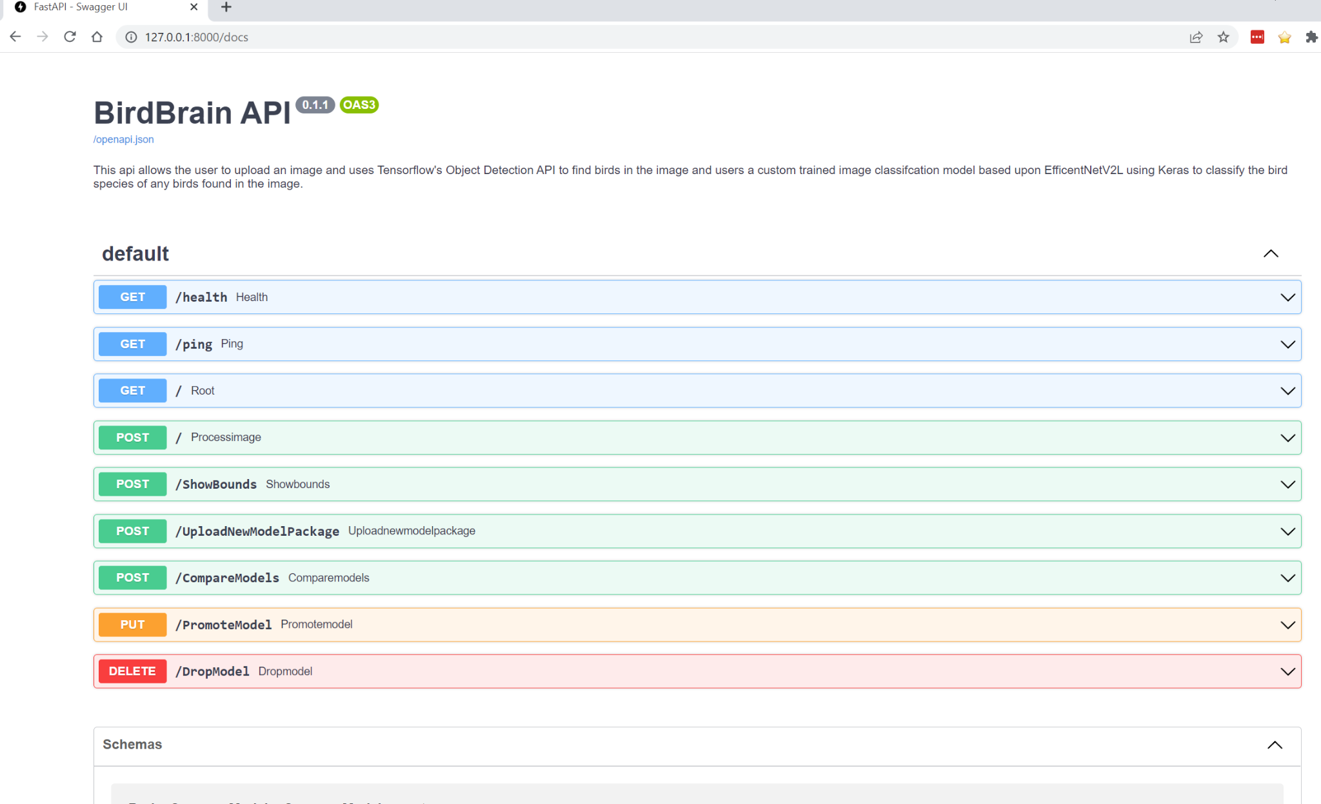
API - Read the docs
One of the really nice things about FastAPI is the fact it automatically provides a test harness through OpenAPI/Swagger.

Slide 9
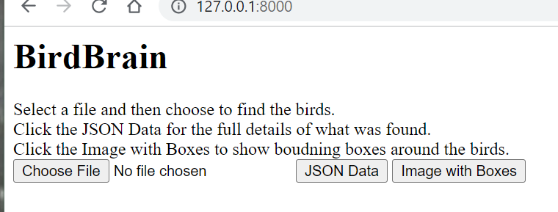
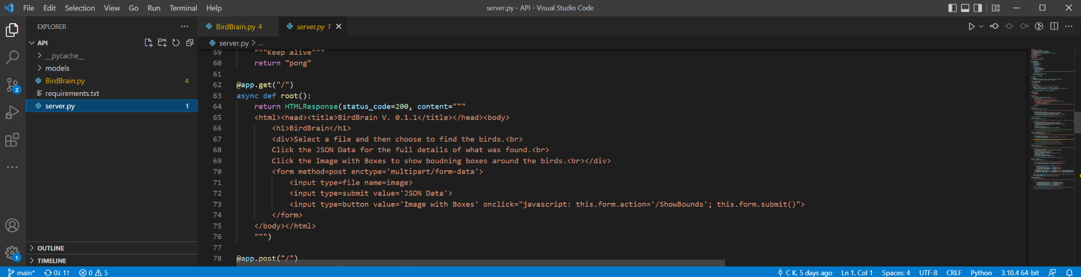
API - Test Harness
One simple thing that you can do to ensure your efforts are useful is to provide an even simpler test harness for the main use case of your models.

Slide 10
BirdBrain Roadmap
Image Augmentation
The current dataset had no significant image augmentation. Flipping the the images as well as rotating should improve accuracy and will be tested next.
Images will be better bound to reduce background noise:
While testing the object detection model it was shown that some of the images were could be isolated better to the birds
Adding More Data
Cornell’s Ornithology Labs released the NABirds dataset.
This dataset contains 550 bird species for just north america but needs to be cleaned and curated to the current format.
Kaggle Bird Species dataset has also been increased to 400 bird species.

Slide 11
Thank you
The project can be found at: https://github.com/tinman-chad/BirdBrain
I can be found at: https://www.linkedin.com/in/chadkprofile/
You can contact the project at: BirdBrain@cfk.me

